Slide 1
Essay writing: Compare and Contrast Essay
Prepared by:
Rasel Kabir
Lecturer, GULC

Slide 2
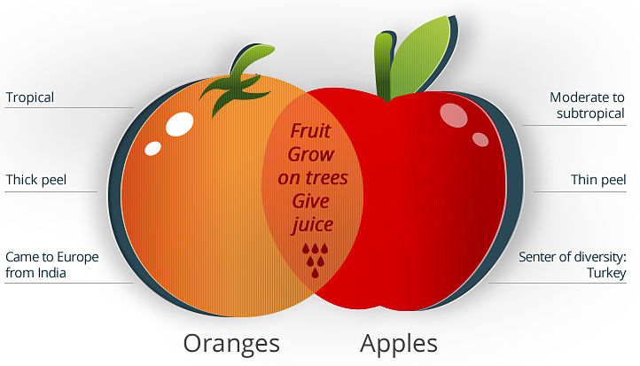

Slide 3
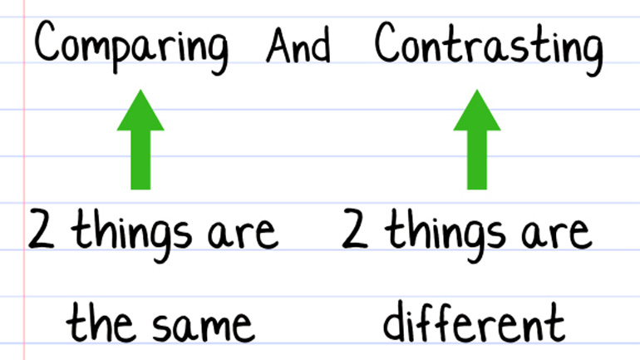
Knowing Compare N Contrast

Slide 4
So…
Compare:
Examine and note the similarities or differences of
Contrast
The opposition or dissimilarity of things that are compared

Slide 5
What does it do?
Describes:
Similarities
Differences
Investigates relationships
Between two things, persons, places, situations etc.
Draws conclusion

Slide 6
Helpful material
Venn Diagram
Is a diagram that uses circles to represent mathematical or logical sets pictorially inside a rectangle.

Slide 7
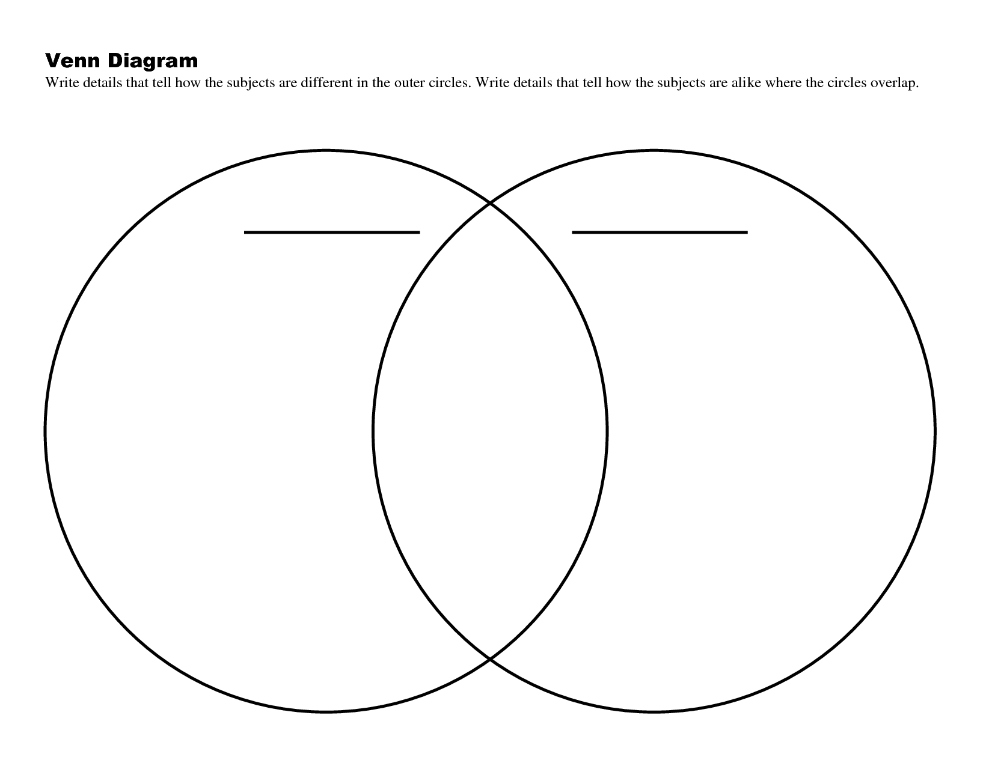
The Venn Diagram

Slide 8
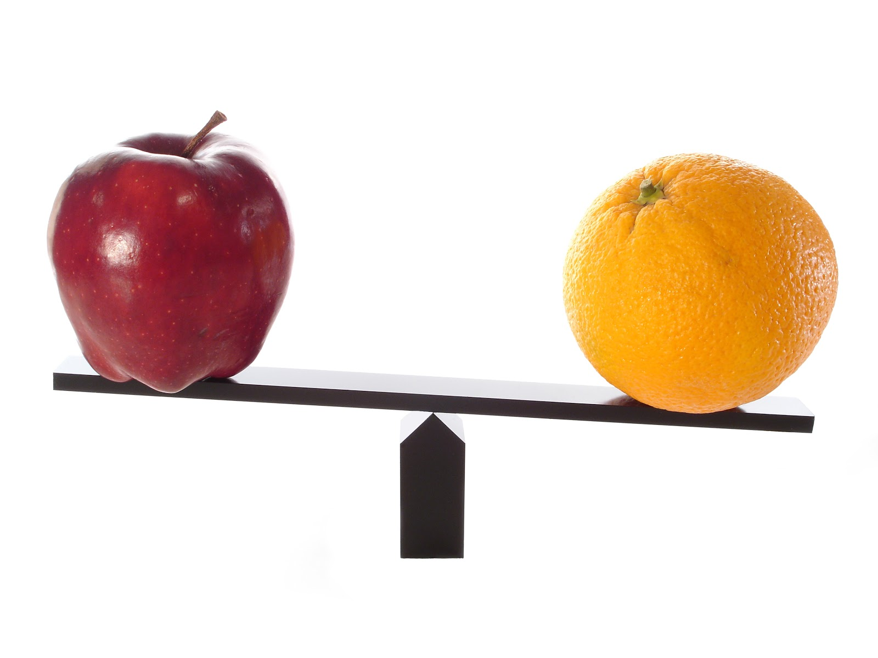
Can you compare & Contrast?

Slide 9
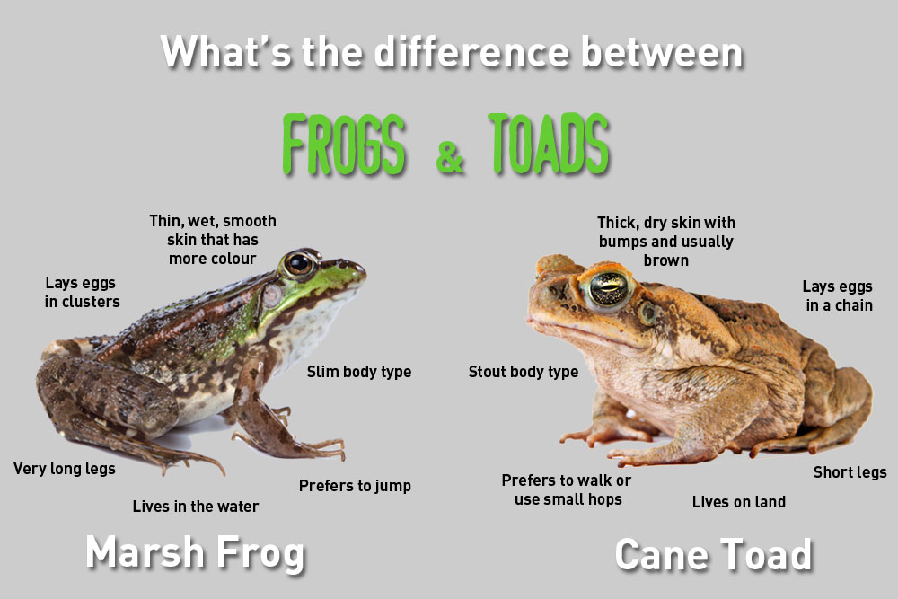
What do you think??

Slide 10
Write a Compare and Contrast Essay on “Toad and Frog”
Introduction (Thesis statement)
Characteristics of Toad
Characteristics of Frog
Common factors
Conclusion
Sample: in next slide

Slide 11
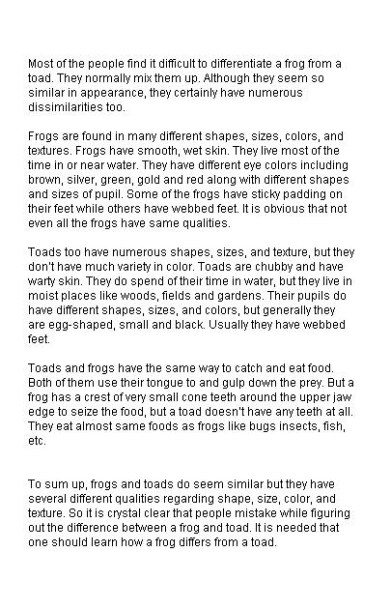

Slide 12
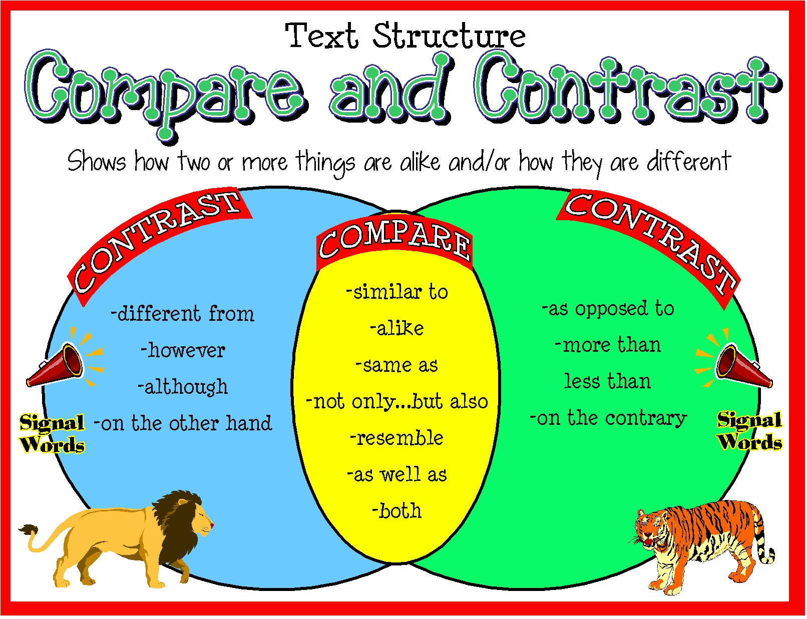
Helpful phrases

Slide 13
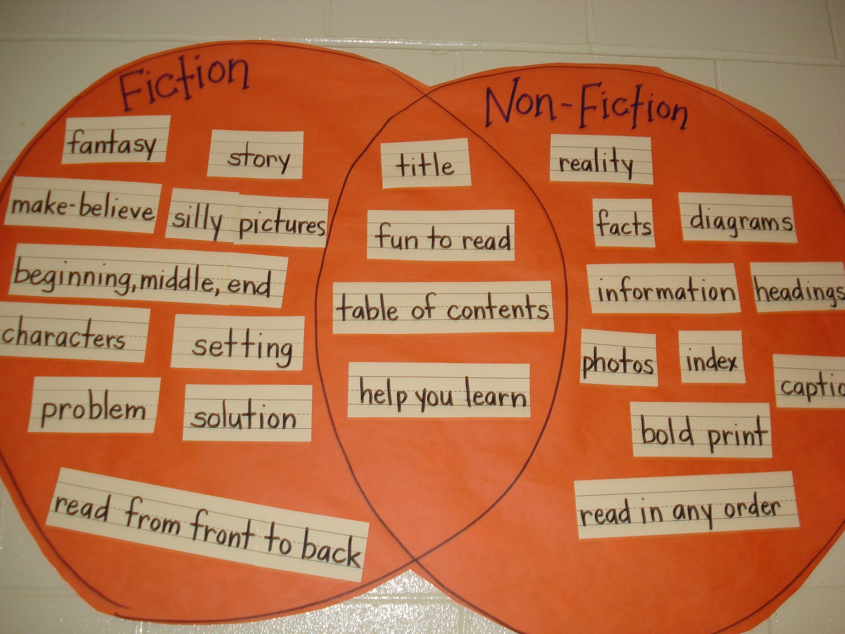
Example

Slide 14
Lets practice @ home
Topic:
Govt. Job and Private Job
☺ ☺ ☺

Slide 15
THANK YOU

